Slide 1
U.S. Aviation:
Predicting Delays & Examining The Resulting Economic Cost
Yeshiva University DAV Math & Statistics Final Project
Group Members: Benjamin Freund, Marlee Goodman, Eli Weiss

Slide 2

Outline Of Presentation
Overview of U.S. aviation
Project questions & goals
Introduction of data architecture & sets
Exploratory data analysis
Hypothesis tests
Predictive modelling
Economic model
Conclusion/final thoughts

Slide 3

Overview of U.S. Aviation
U.S. airlines passenger count: 1B+ ; average daily passenger count: 2.5M+.
U.S. aviation provides: 10 million+ jobs and nearly $500 billion in revenue
Revenue from aviation constitutes approx. 5% of American’s GDP annually
Cost of delays for U.S. flights: $33B; $8.3B of that cost is borne by the airlines
2019 delays were highest at Newark (EWR), LaGuardia (LGA), Chicago O’Hare (ORD), and San Francisco (SFO), each with over 30,000 delays
Collectively, these four airports accounted for over one-half of all ‘Core 30’ airport delays.
Sources:
https://www.airlines.org/data/
https://www.faa.gov/air_traffic/by_the_numbers/media/Air_Traffic_by_the_Numbers_2020.pdfhttps://www.faa.gov/data_research/aviation_data_statistics/media/cost_delay_estimates.pdf

Slide 4

Project Questions, Goals, & Parts
Research Questions:
What variable are predictive of flights being delayed?
What is the estimated cost associated with the delay?
Goal: For business operations, airline industry - estimate chances of a flight being delayed via our model, and consequently calculate how much money the delay would cost the airline. Important for individual U.S. business, but also for overall GDP.
Components (in order):
Datasets, EDA (Marlee as lead), Hypothesis Tests (Ben as lead), Modelling (Eli as lead), Aviation Research (Marlee as lead)

Slide 5

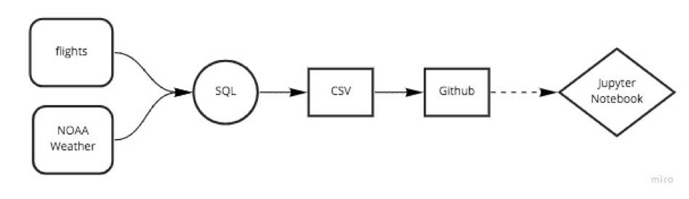
Data Architecture
https://github.com/MarlaGoodman/CMS-Project

Slide 6
Datasets Introduction
1.Data Source: Bureau of Transportation Statistics for the US Department of Transportation
http://www.transtats.bts.gov/DL_SelectFields.asp?Table_ID=236
Compiled by: https://github.com/jayleetx/nycflights
Key Points:
Summary - Info for US flights departing from major NYC airports (Newark, Laguardia, & JFK)
Year: 2017
Dataset contains 18 variables
Snapshot of 303,748 flight cases:
2. Data Source: National Oceanic Atmospheric Administration (NOAA): https://w2.weather.gov/climate/xmacis.php?wfo=okx
Weather (rain, snow) conditions for each day of 2017, for every flight from EWR, LGA, JFK

Slide 7
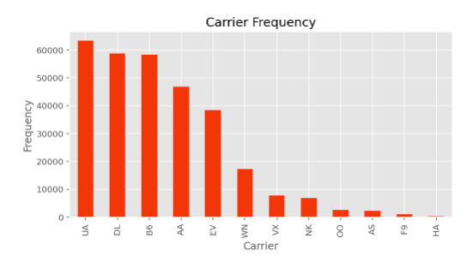
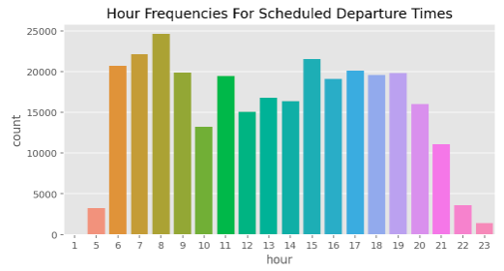
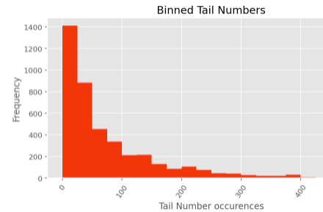
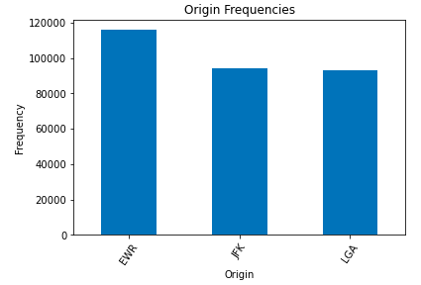
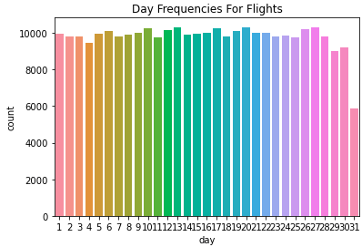
EDA

Slide 8
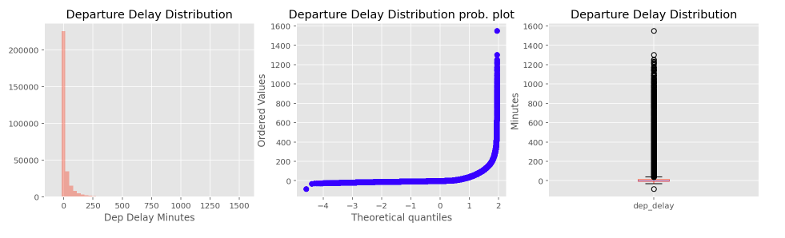
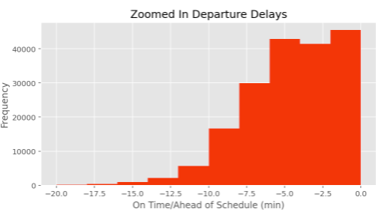
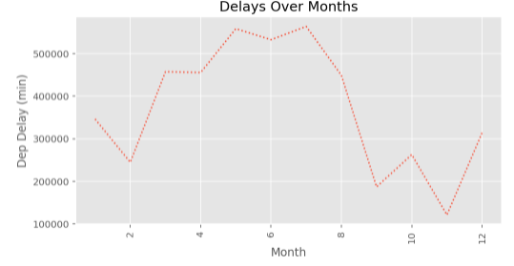
Data is skewed to the right

Slide 9
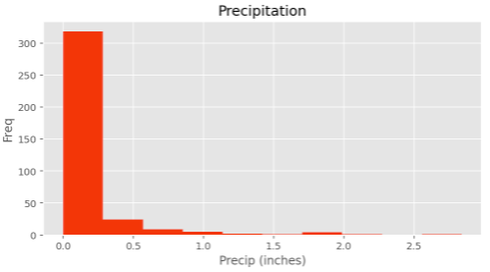
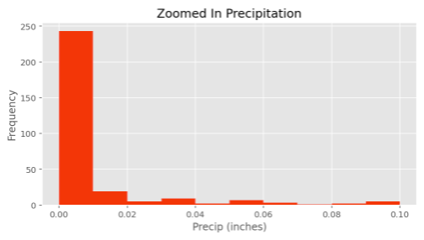
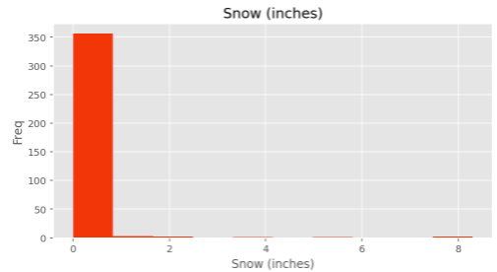
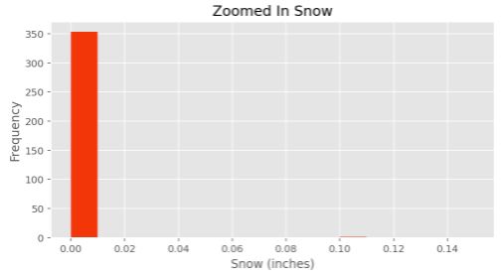

Slide 10
Hypothesis Test #1:
Weekend Delays vs. Weekday Delays
H₀: There is no difference between average weekend delays and average weekday delays,
or total_delay_{weekend} – total_delay_{weekday} = 0.
H_{A}: There is a statistically significant difference between average weekend delays and average weekday delays,
or total_delay_{weekend} – total_delay_{weekday} != 0.

Slide 11
Conditions for T-Test
(Comparing Means of Two Groups)
Sample Size
Both weekend and weekday samples contain 190 observations each, which is more than the standard 30
Independence
Both samples are less than 10% of the overall population (303,748 observations), so they can be considered independent.
Randomness
Simple random samples taken using Python
Normally Distributed
Skewed right, but due to large sample size, we can proceed with caution
Notes:
Image: https://www.google.com/url?sa=i&url=https%3A%2F%2Ftechysupport.co%2Fterm-and-condition%2F&psig=AOvVaw3tUFxDRhCnPnshxCO4dhvR&ust=1618522745743000&source=images&cd=vfe&ved=0CAIQjRxqFwoTCPjQnarZ_u8CFQAAAAAdAAAAABAE

Slide 12

Results
T - Statistic: 1.10
P - Value: 0.27
Fail to reject H₀ at 95% confidence level
No statistically significant difference between average weekend delays and average weekday delays
Notes:
Image: https://www.google.com/url?sa=i&url=https%3A%2F%2Fwww.iconsdb.com%2Fred-icons%2Fthumbs-down-icon.html&psig=AOvVaw35Fe5FebcMezPe5Bot2XjE&ust=1618522825664000&source=images&cd=vfe&ved=0CAIQjRxqFwoTCIDLzMnZ_u8CFQAAAAAdAAAAABAE

Slide 13
Hypothesis Test #2:
Snow Induced Delays vs. Rain Induced Delays
H₀: There is no difference between average snow induced delays and average rain induced delays,
or total_delay_{snow} – total_delay_{rain} = 0.
H_{A}: There is a statistically significant difference between average snow induced delays and average rain induced delays,
or total_delay_{snow} – total_delay_{rain} != 0.

Slide 14
Conditions for T-Test
(Comparing Means of Two Groups)
Sample Size
Both snow and rain samples contain 190 observations each, which is more than the standard 30
Independence
Both samples are less than 10% of the overall population (303,748 observations), so they can be considered independent.
Randomness
Simple random samples taken using Python
Normally Distributed
Skewed right, but due to large sample size, we can proceed with caution

Slide 15

Results
T - Statistic: 2.414
P - Value: 0.016
Reject H₀ at 95% confidence level
Statistically significant difference between average snow induced delays and average rain induced delays
Notes:
Image: https://www.runnerstribe.com/membership-join/membership-registration/attachment/286-2862058_thumbs-down-buttons-royalty-free-cliparts-vectors-green/

Slide 16

Machine Learning - Variables and Response
Response: Delayed 1/0
Stratified X’s:
Hour (1-24) (1 Hot Encoded)
Month (1-12) (1 Hot Encoded)
Rain(0/1)
Snow(0/1)
# Flights per carrier per airport per day
Running count of delays for this plane

Slide 17
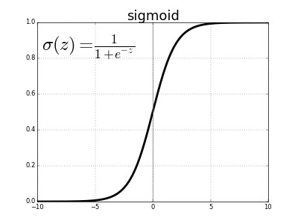
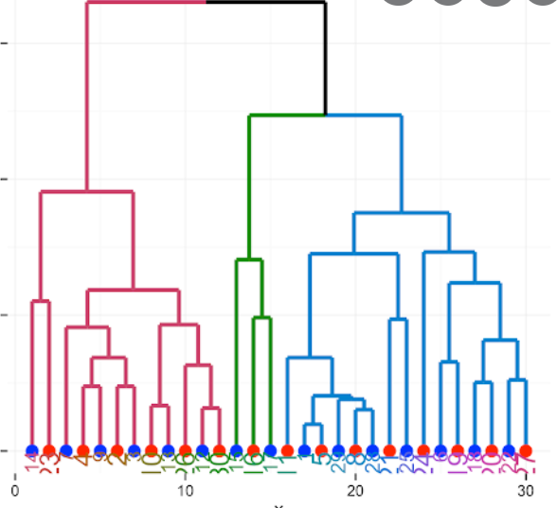
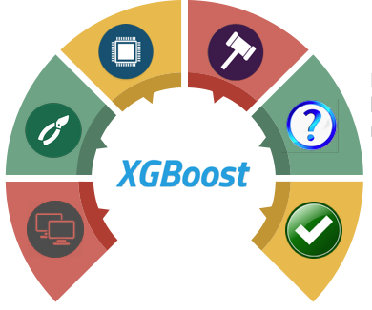
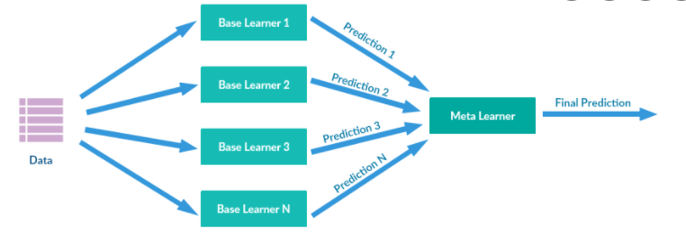
Machine Learning - Models
Models:
Logistic Regression
Random Forest
XGBoost
Ensemble (Logistic Regression + Random Forest)

Slide 18
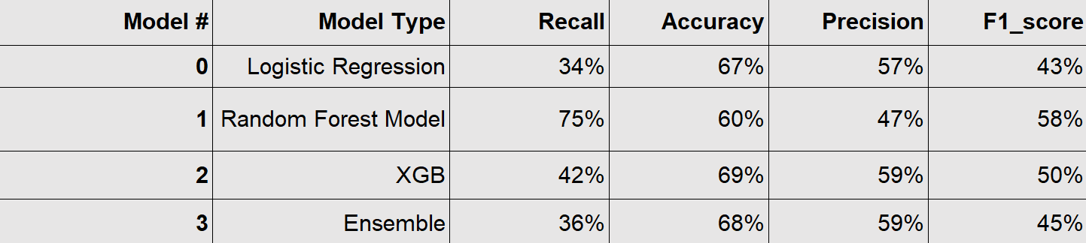
Performance - Metrics
(On average, 36% of flights are delayed)

Slide 19
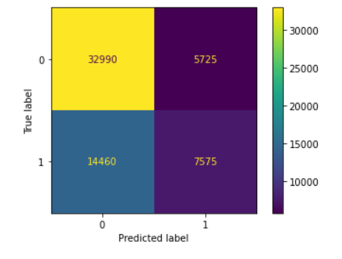
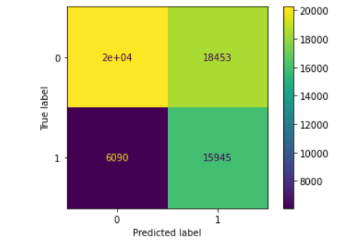
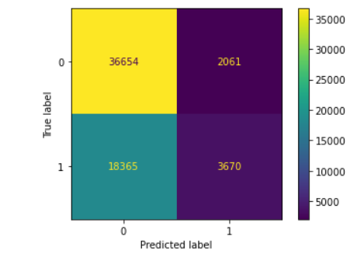
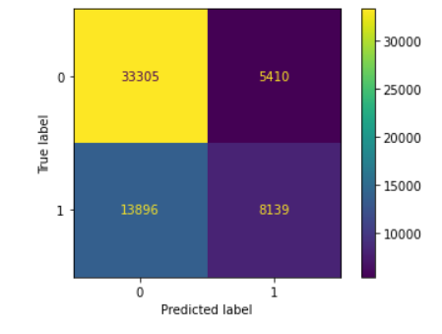
Performance CM
(On average, 36% of flights are delayed)
Log Regression
Random Forest
XGBoost
Ensemble

Slide 20
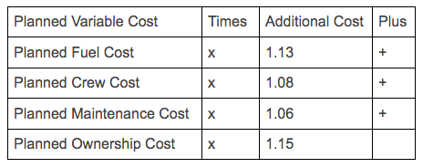
Economic Model
Major airline cost components for delays: fuel, crew, maintenance, ownership (Depreciation, leasing costs, insurance, etc.)
Basic Method For Each Part:
Research how much each component costs in total
Determine how much of that is due to delay
Calculate cost of delay per component
Fuel - If a flight is delayed, the airline can expect to increase its fuel cost for that flight by 13% on average.
Crew - 6% ; Maintenance - 8% ; Ownership - 15%

Slide 21

Conclusion: Items Learned & Future Steps
Items learned:
A lot of aviation data via FAA, BTS, etc.
The trade off between recall and precision
Hypothesis testing via Python packages
Future Action:
Test more variables to determine whether they should be included/excluded from model
Develop model to increase recall and precision
Notes:
Image: https://www.dreamstime.com/photos-images/future-steps.html

